Slide 1
Tune Scape
Wenjia Luo Yueqian Wu
Lei Bian

Slide 2

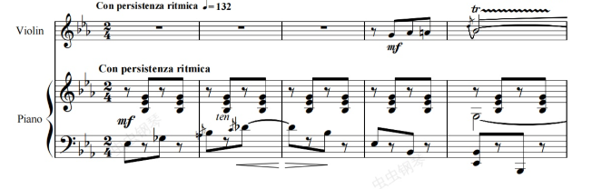
Motivation & Overview
Motivation:
Architecture is frozen music.
This project aims to ransforming architecture and place into living sound.
Core Features:
Interactive map-based interface
Image and location analysis
Music generation based on visual and geographical cues

Slide 3
Technical Architecture
Frontend Stack:
React with Vite
Google Maps JavaScript API
Backend Stack:
Flask
SQLite / PostgreSQL for data storage (AI approach only)
Asynchronous task handling for API calls (AI approach only)
Music Generating (two approaches):
Google Gemini API for image and location analysis
Suno AI API for music generation
Hugging Face Transformers :
(BLIP, CLIP, Flan-T5 Small, MusicGen-small)
Encodec (VQ-VAE audio codec)
Geopy + Wikipedia-API

Slide 4
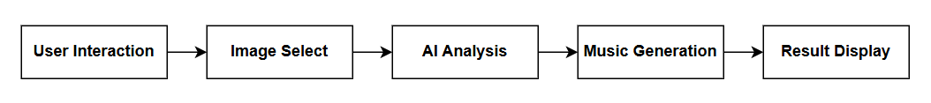
System Workflow
User Interaction: Users select a location or search for a place on the map.
Image Select: The system fetches the Street View image of the selected location.
AI Analysis: Gemini AI analyzes the visual content and cultural context of the image.
Music Generation: Suno AI generates music based on the analysis results.
Result Display: The generated music is presented.

Slide 5
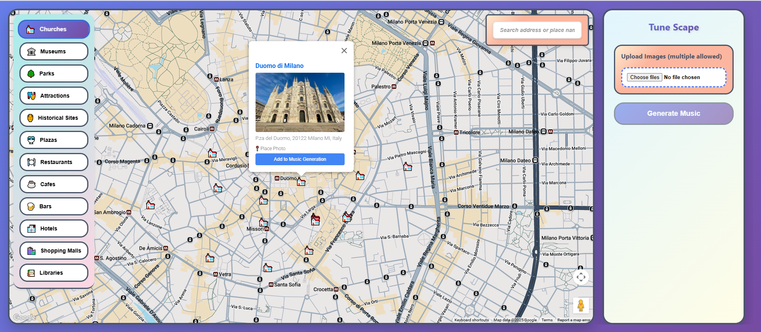
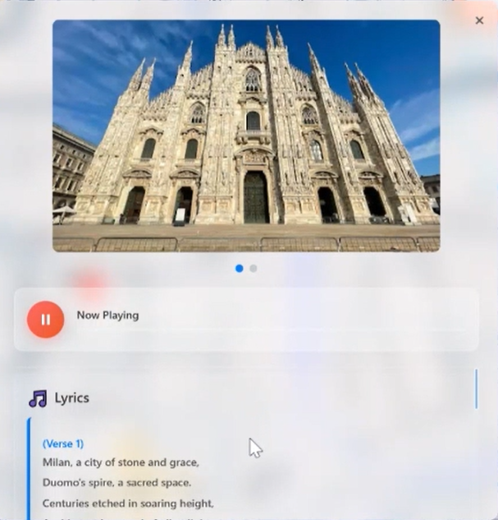
Frontend-User Experience
Responsive Design
Optimized for different screen sizes and devices
Intuitive Interaction
Users can generate music by simply clicking on a location on the map
Visual Feedback
Real-time loading indicators and progress updates
Music Playback Interface
Integrated player displays the generated music, lyrics, and corresponding image

Slide 6
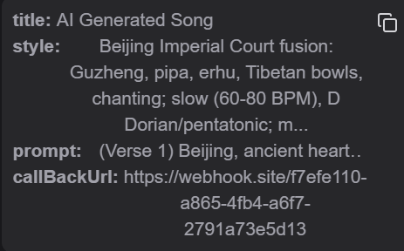
Backend-AI enpowered
Gemini API
Analyzes visual content from location images
Extracts cultural context, musical atmosphere (e.g., music_style, cultural_context, mood, tempo)
Generates lyrics based on the image and its semantic meaning
Suno AI for Music Generation
Composes music based on visual mood, cultural cues, and generated lyrics
Highlights
Multimodal interaction across image, text, and music domains Create a AI Workflow from image to music

Slide 7
Backend-Database Design
MusicTask Table
Manages music generation tasks
Tracks task status flow: pending → analyzing → generating → completed
Stores AI analysis results (e.g., mood, style, lyrics)
CallbackLog Table
Logs external API callbacks (e.g., Suno response is asynchronous task )

Slide 8
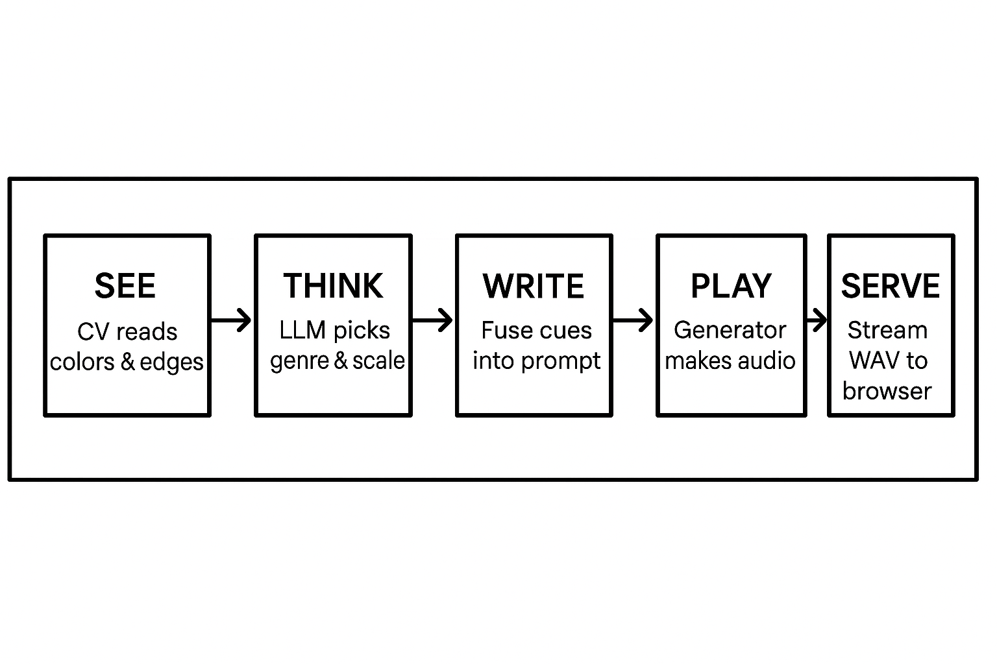
Backend- Another Parallel Approach：Open-source stack
The backend runs a five-stage pipeline that sees, thinks, and plays:
The next slides break down each of these stages.
Notes:
And we have also developed a parallel approach to generate music at the consideration of open source.
It can be described as a five stage pipeline.
First it sees. We use cv to analyse the image.
second it thinks. It will picks a suitable sytle and scale.
Next it write. It combine all the cues into a prompt
After that, it plays the music and serves it to the browser.
Then we'll have a detailed breakdown of the stages.

Slide 9
Backend-Another Parallel Approach：Open-source stack
1. Visual Analysis
Captioning – Each image first goes through BLIP to get a one-sentence description.
Caption Expansion (Flan-T5) – When the refine_description flag is true, those BLIP captions are sent to Google Flan-T5 Small, elaborating them into richer, location-aware sentences .
Low-level cues – Convert the image to HSV and grayscale to extract:
Hue → chooses major / minor key (warm = major, cool = minor)
Value (brightness) → maps to dynamics (loud ↔ soft)
Edge density (Sobel gradient) → sets tempo (high = fast, low = slow)
Notes:
At the stage of visual analysis. the image will first go throug blip to get a simple description.
If the user turn the refine_description ture, it will then go through Flan to get a caption expasion to get a richer description.
And the low level cues are also captured and mapped into music features.
Like hue mapped to major or minor key.
brightness mapped to dynamics
Edge density mapped to temple.

Slide 10
Backend-Another Parallel Approach：Open-source stack
2. Style & Tonality Matching
Style inference – If the user does not set style, CLIP ranks ten preset genres (ambient, folk, epic …) against image embeddings and picks the top score.
Traditional scale –
Reverse-geocode lat/lon with Geopy to get the country.
Search that country’s Wikipedia summary for modal keywords (maqam, raga, pelog …).
If nothing is found, query Flan-T5 : “Name one traditional musical scale used in the folk music of <country>.”
Notes:
Then it is the stage style and tonality matching.
If the user doesn't define a specific style, It will use Clip to rank ten preset genres and pick the most suitable one.
For the scale mode, it will get the country using the location and then automatically search the wiki for its traditional mode. If not found, it will query Flan to get the traditional scale mostly used in this country.

Slide 11
Backend-Another Parallel Approach：Open-source stack
3. Prompt Engineering
Combine location label, chosen style, key/dynamics/tempo cues, any traditional mode, and all (optionally expanded) captions into a single paragraph (< 120 tokens).
4. Music Synthesis
Send the prompt to MusicGen-small. The model outputs stereo audio latents, decoded by Encodec (VQ-VAE).
5. Response Pipeline
Flask writes the WAV to a temporary file, streams it back as audio/wav, and cleans up all temp data.
Notes:
After that, all the cues (like location label, chosen style, key/dynamics/tempo cues, any traditional mode) are combined into a prompt. And the prompt is sent to Music gen, which outputs stereo audio latents, decoded by Encodec (VQ-VAE). Finally the generated audio file is streamed back

Slide 12



Backend-Another Parallel Approach：Open-source stack
Music Examples:
Website: Music Map

Slide 13
Thanks for Listening

